Slide 1
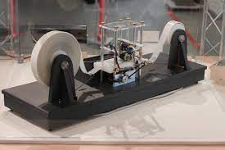
TURING MACHINE SIMULATION
BY:
JAYANT RANA (2K19/CO/177)
Lakshmi Sai Srikar V (2K19/CO/208)

Slide 2
WHAT IS A TURING MACHINE?
A Turing Machine (TM) is a mathematical model which consists of an infinite length tape divided into cells on which input is given. It consists of a head which reads the input tape. A state register stores the state of the Turing machine. After reading an input symbol, it is replaced with another symbol, its internal state is changed, and it moves from one cell to the right or left. If the TM reaches the final state, the input string is accepted, otherwise rejected.
A TM can be formally described as a 7-tuple (Q, X, ∑, δ, q₀, B, F) where −
Q is a finite set of states
X is the tape alphabet
∑ is the input alphabet
δ is a transition function; δ : Q × X → Q × X × {Left_shift, Right_shift}.
q₀ is the initial state
B is the blank symbol
F is the set of final states

Slide 3
OBJECTIVE
Our aim in this project is to simulate a turing machine and check if a given string is a palindrome or not.
We show the process step by step and the rules followed to do so are given in the next slide.

Slide 4
ALGORITHM
Initially we start off at state q1, and store it.
We move the tape head until the end of the string and look for the 0. We store the final letter and compare it to the letter found at the start at q1.
If they are equal, the first letter is updated to 0 and we go to state q2, i.e successful comparison and the iteration starts again.
If unequal we go to state rn, and the program terminates with output, NOT PALINDROME.

Slide 5
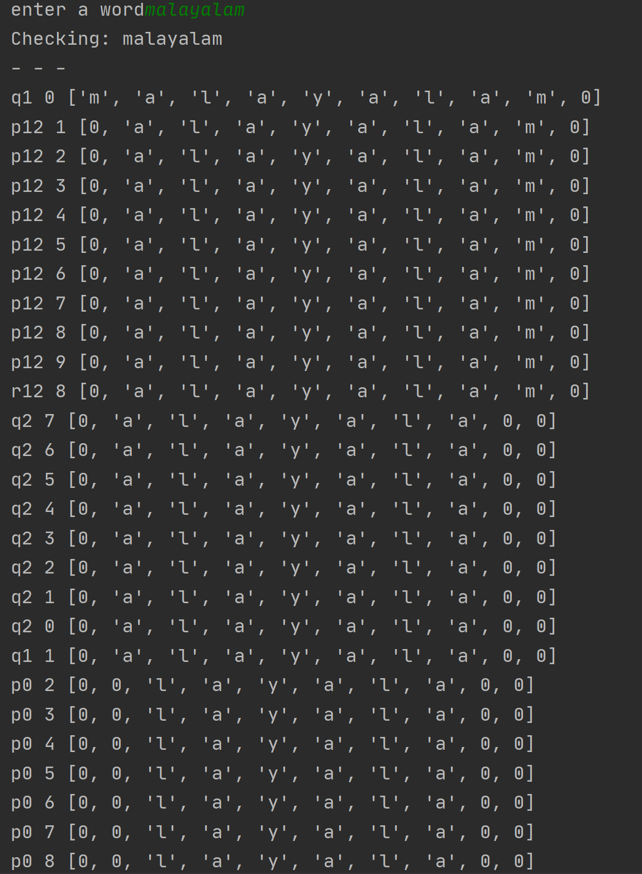
WORKING WITH EXAMPLE

Slide 6
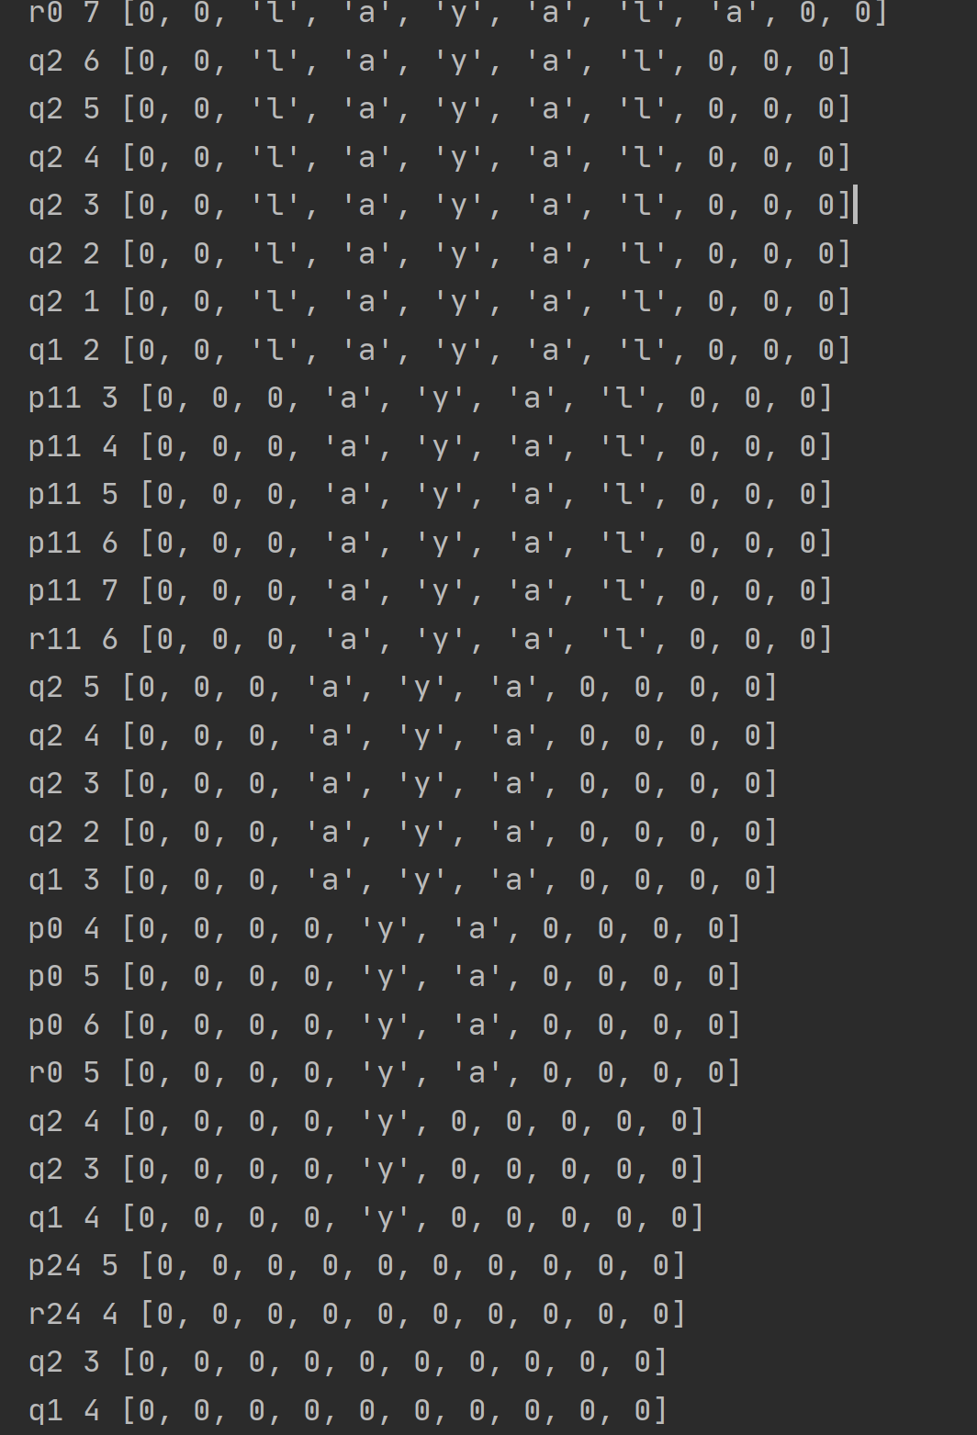
CONTD.

Slide 7
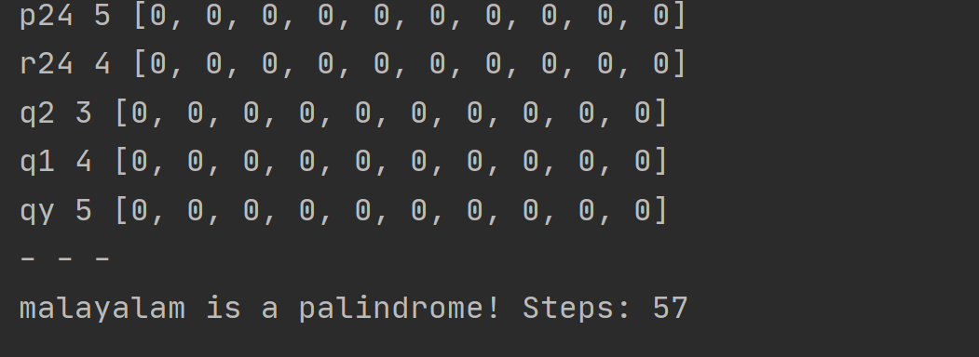
CONTD.

Slide 8
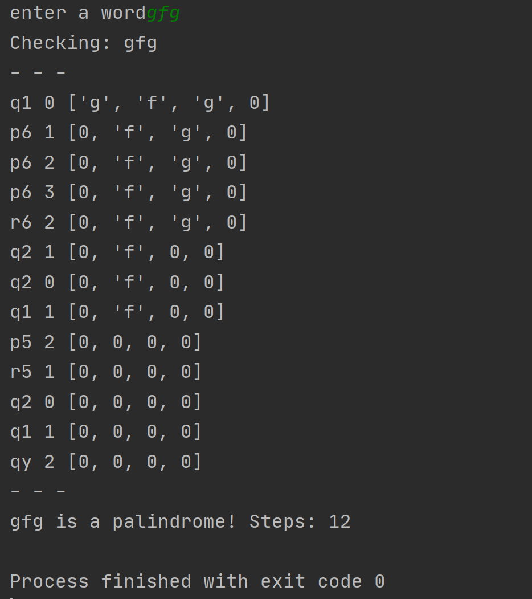
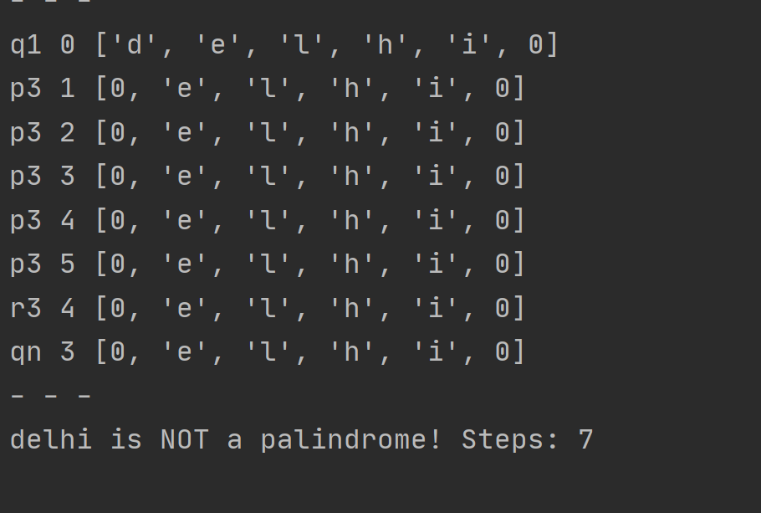
OUTPUT SCREENSHOTS

Slide 9
REFERENCES
www.tutorialspoint.com
www.youtube.com/neso-academy
www.Wikipedia.com

Slide 10
THANK YOU !

